Slide 1
Rotational invariance of image using MUSIC algorithm
BATCH 1- Group 1:
GURUKUMAR K C (CB.EN.U4ECE22118)
GURUKARTHI K C (CB.EN.U4ECE22119)
KORADA BALAJI HARSHAVARTHAN (CB.EN.U4ECE22128)
KOUSHIK B (CB.EN.U4ECE22130)

Slide 2


MOTIVATION:

Slide 3



Slide 4
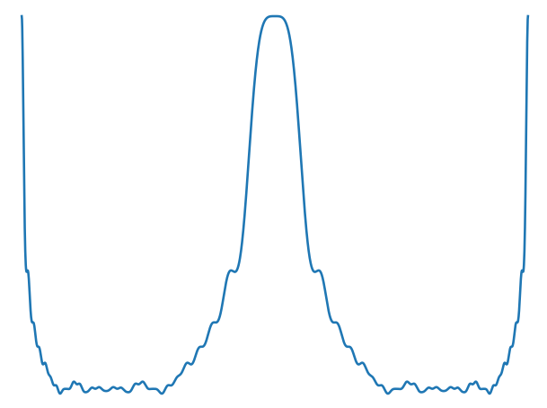
MUSIC ALGORITHM

Slide 5
Problem statement
To use MUSIC algorithm on images to see if it can pick out rotational invariant property of the image.

Slide 6
Objective:
To reduce computational complexity
Unique approach to data processing accounting for hardware constraints
Give a compact output to reduce the size of dataset.

Slide 7
LITERATURE SURVEY:
Author | Year | DOA | Algorithm | Computational efficiency
Barabell, A. J. | 1983 | 1.21% | Eigenvalue Decomposition | 192ms
J. Shi, C. Tomasi | 1994 | 3.86% | LBP with Local Fourier Transform. | 145ms
Zoltowski, M. D. & Mathews, M. E. | 1993 | 5% | ESPRIT | 92ms
J. Yang, W. Hu | 2008 | 2% | Local Binary Patterns with Local Fourier Transform for Face Recognition | 351ms

Slide 8
LITERATURE SURVEY:
Author | Year | DOA | Algorithm | Computational efficiency
David Lowe | 1999 | 4.71% | SIFT | 83.72ms
Flora Dellinger | 2013 | 2.02% | SAR-SIFT | 352.48ms
Henrik Skibbe and Marco Reisert | 2012 | 2.39% | Fourier HOG | 246.15ms
Yunhao Chang | 2015 | 1.91% | Fourier HORG | 437ms
Xu, G. & Hong, M | 2012 | 5.37% | Improved ESPRIT | 97ms

Slide 9
Workflow:
Importing libraries
Loading the image
Declaring array response vector
Measure response array points
Peak detection using MUSIC spectrum
Declare image and array range (-90 to 90 degree)
Call function and plot DoA

Slide 10

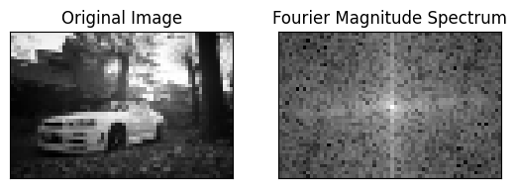
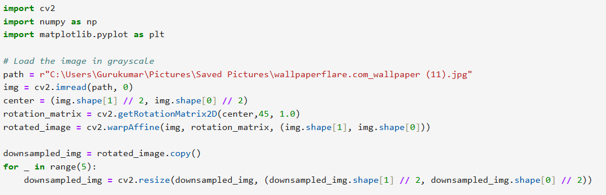
Data pre-processing:
Sample image
Down sampled image and it's Fourier transform

Slide 11
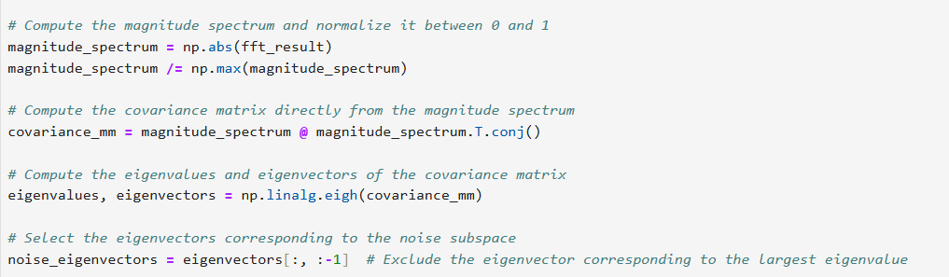
Covariance and eigen value decomposition
Finding normalized matrix
Calculating covariance matrix
Eigen value decomposition
Splitting noise subspace

Slide 12
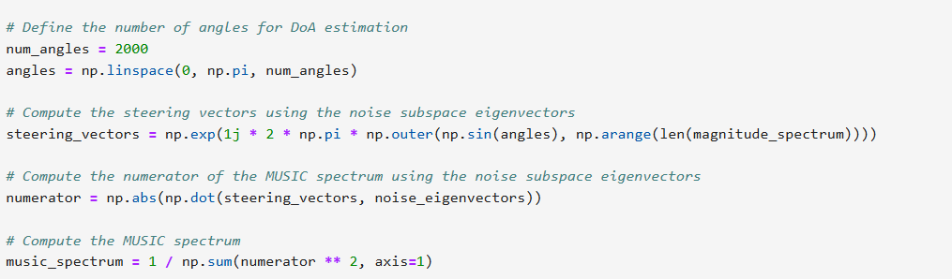
MUSIC spectrum prediction
Defining x axis for the plot
Finding steering vector
Calculating MUSIC spectrum

Slide 13

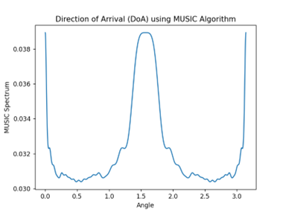

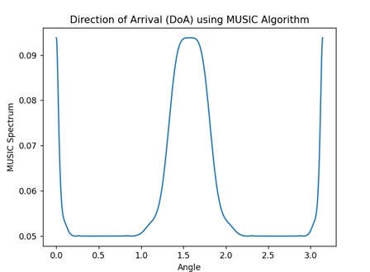
Result:
Fig R1: A multichromatic image
Fig R2: MUSIC spectrum for Fig R1
The spectrum for the above image is rotationally invariant up to a maximum of 8 degrees
Fig R3: A monochrome image
Fig R4: MUSIC spectrum of Fig R3
For a binary image (as shown in the figure) the spectrum is rotationally invariant up to 40 degrees

Slide 14
Discussion:
We got higher rotational invariance for binary images (similar to those used in security cameras) with less computational process than other methods used.
The MUSIC spectrum is unique for each image.
The data obtained is compact – image had a maximum of 5-8 data points for identification.
The algorithm had a maximum computation time is 26ms.

Slide 15
References
O. R. Qing Wang, "Rotational Invariance Based on Fourier," IEEE, 2009. K. Fu and E. Persoon, "Shape discrimination using Fourier descriptors," IEEE Trans. Pattern Anal. Mach. Intell., vol. PAMI-8, no.3, pp.388-397, 1986. W. Kosmala, "Advanced calculus: A friendly approach," Prentice- Hall, 1999. Z. Yang and S. Kamata, "Fast polar and spherical Fourier descriptors for feature extraction," IEICE Trans. Inf. & Syst., vol.E93-D, no.7, pp.1708-1715, 2010. C.S. Burrus and T.W. Parks, DFT/FFT and Convolution Algorithms and Implementation, John Wiley & Sons, 1985. J. Dence and T. Dence, Elements of the Theory of Numbers, Har- court Academic Press, 1999. R. Guy, Unsolved Problems in Number Theory, 3rd ed., Springer Press, 2004. G. Hardy and E. Wright, An Introduction to the Theory of Numbers, 6th ed., Oxford University Press, 2008. S. Winograd, "On computing the discrete Fourier transform," Math- matics of Computation, vol.32, no. 141, pp.175-199, 1978. P. Shilane, P. Min, M. Kazhdan, and T. Funkhouser, The Princeton Shape Benchmark, Shape Modeling International, 2004. O. Ronneberger, E. Schultz, and H. Burkhardt, “Automated Pollen Recognition Using 3D Volume Images from Fluorescence Microscopy,” Aerobiologia, vol. 18, pp. 107-115, 2002. H. Burkhardt, Transformationen zur lageinvarianten Merkmalgewinnung, Ersch. als Fortschrittbericht (Reihe 10, Nr. 7) der VDI-Zeitschriften. VDI-Verlag, 1979. O. Ronneberger, J. Fehr, and H. Burkhardt, “Voxel-Wise Gray Scale Invariants for Simultaneous Segmentation and Classification,” Proc. 27th DAGM Symp., pp. 85-92, 2005. Q. Wang, O. Ronneberger, and H. Burkhardt, “Fourier Analysis in Polar and Spherical Coordinates,” internal report, http://lmb.informatik.unifreiburg.de/papers/, 2008. C.C. Chang and C.J. Lin, “LIBSVM—A Library for Support Vector Machines,” http://www.csie.ntu.edu.tw/cjlin/libsvm/, 2009. FFTW Home Page, http://www.fftw.org/, 2009. Fast Spherical Harmonic Transforms, http://www.cs.dartmouth.edu/ geelong/sphere/, 2009. The Gnu Scientific Library, http://www.gnu.org/software/gsl/, 2009 (Comparative Study of High-Resolution Direction-of-Arrival Estimation Algorithms for Array Antenna System, 2012) ( https://www.youtube.com/watch?v=BMCNaLFcxxE&ab_channel=IITKANPUR-NPTEL) R.Roy ,A.PAULRAJ,T.KAILATH ,"Estimation of Signal Parameters via Rotational Invariance Techniques –ESPIRIT"

